Slide 1
Feature Extraction
Tim Pengajaran
Mata Kuliah Machine Learning
Jurusan Teknologi Informasi Tahun 2021

Slide 2
Disclaimer
This presentation material, including examples, images, references are provided for informational and explanation assistance only
The names of actual products and companies mentioned here in, if any, may be the trademarks of their respective owners
Credits shall be given to the images taken from the open-source and cannot be used for promotional activities

Slide 3
Outline
What is Recognition, Pattern, Feature, Feature Extraction?
Standardizing Features
Extracting Features from Categorical Variables
Extracting Features from Text
Extracting Features from Images

Slide 4
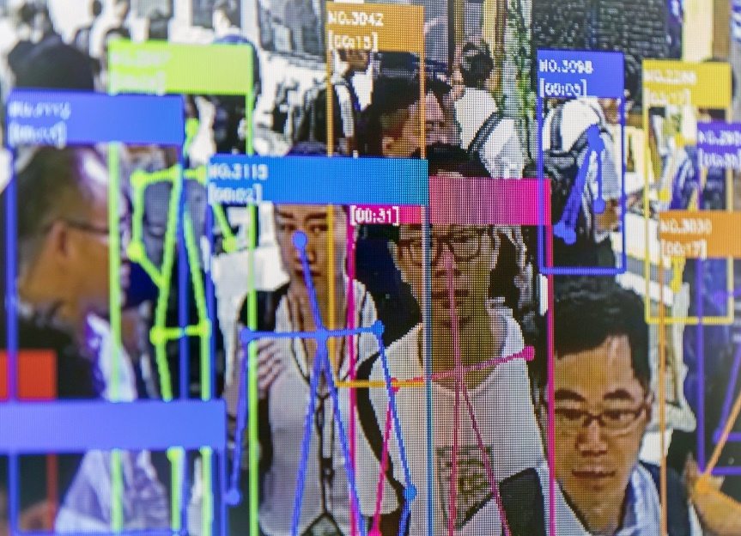
What is Recognition and Pattern?
Recognition is regarded as a basic attribute of human beings, as well as other living organisms.
Recognition is carried out by looking for pattern, namely the description of an object.

Slide 5
Types of Recognition
The recognition of concrete items.
Recognizing characters, pictures, music, and objects around us.
Called as sensory recognition (visual and aural pattern recognition)
The recognition of abstract items.
Recognizing old argument, solution of problems while eyes and ears closes.
Called as conceptual recognition.

Slide 6
Pattern Recognition
The categorization of input data into identifiable classes via the extraction of significant features or attributes of the data from a background of irrelevant detail.
Recognition is to distinguish and classify object.
The problem is the discrimination of the input data between population via the search for features or invariant attributes among members of a population.

Slide 7
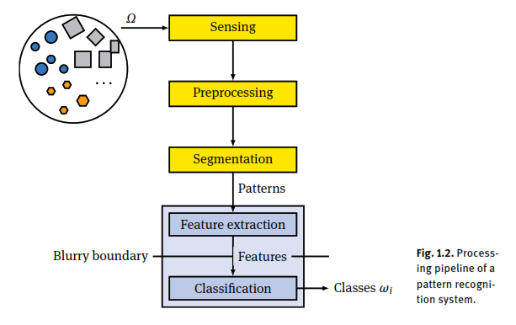
A Pattern Recognition System

Slide 8
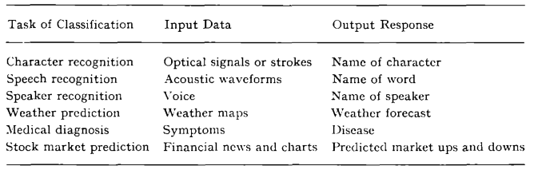
Classification Tasks

Slide 9
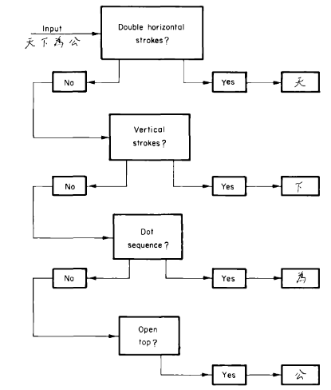

What is Feature?
Feature is attribute, characteristic, traits, marks, or something special about an object.

Slide 10
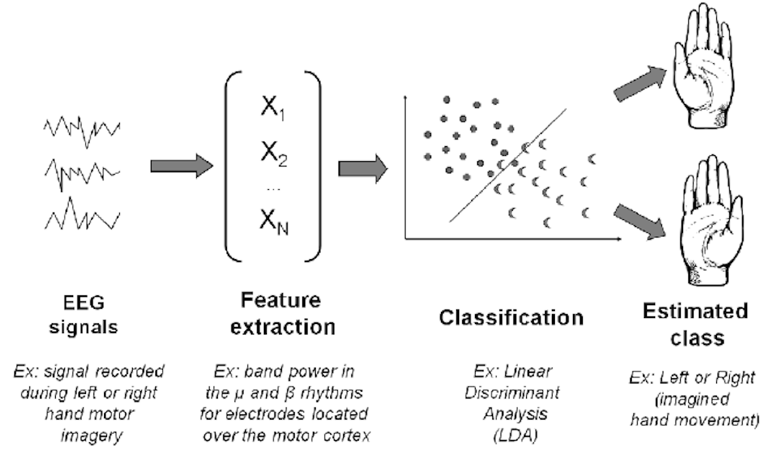
Feature Extraction
A process of dimensionality reduction by which an initial set of raw data is reduced to more manageable groups for processing.

Slide 11
Standardizing features
Learning algorithms perform better when they are trained on standardized data, namely data that has zero mean and unit variance.
An explanatory variable with zero mean is centered about the origin; its average value is zero.
A feature vector has unit variance when the variances of its features are all of the same order of magnitude.
If one feature's variance is orders of magnitude greater than the variances of the other features, that feature may dominate the learning algorithm and prevent it from learning from the other variables.
Some learning algorithms also converge more slowly when data is not standardized.

Slide 12
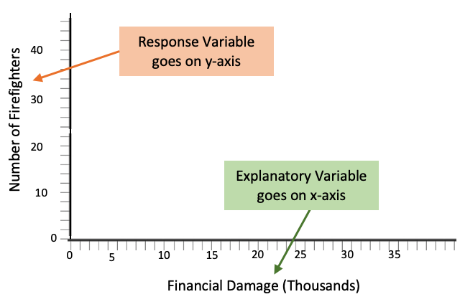
Extracting Features from Categorical Variables
Many problems have explanatory variables that are categorical or nominal, which can take one of a fixed set of values.
Explanatory variable is independent variable that explain the observed outcomes.
Response variable is dependent variable that measure the outcome of study or the manipulation of the explanatory variable.

Slide 13
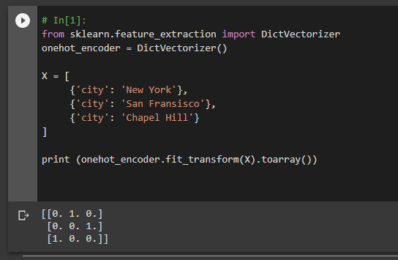
Extracting Features from Categorical Variables – One-hot Encoding
Commonly encoded using one-of-k encoding, or one-hot encoding, in which the explanatory variable is represented using one binary feature for each of its possible values.

Slide 14
Extracting Features from Text
Text must be transformed to a vector representation that encodes some aspect of its meaning.
The bag-of-words model
Stop word filtering
Stemming and lemmatization
Extending bag-of-words with TF-IDF weights
Space-efficient feature vectorizing with the hashing trick
Word embeddings

Slide 15
The Bag-of-Words Model
Uses a multiset, or bag, that
Encodes the words that appear in a text.
Does not encode any of the text's syntax.
Ignores the order of words.
Disregards all grammar.
Can be thought of as an extension to one-hot encoding. It creates one feature for each word of interest in the text.
Is motivated by the intuition that documents containing similar words often have similar meanings.
Can be used effectively for document classification and retrieval despite the limited information that it encodes.
A collection of documents is called a corpus.

Slide 16
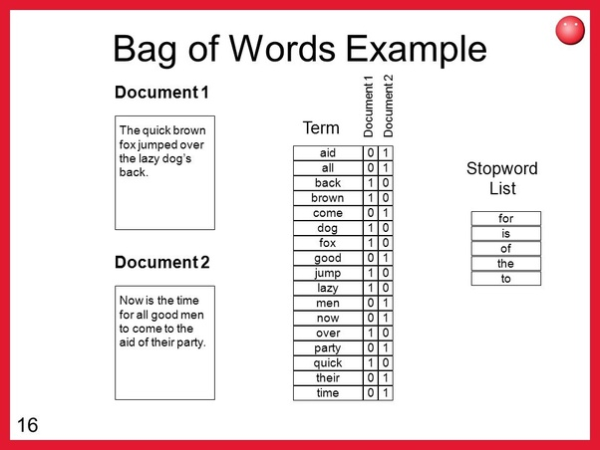
The Bag-of-Words Model

Slide 17
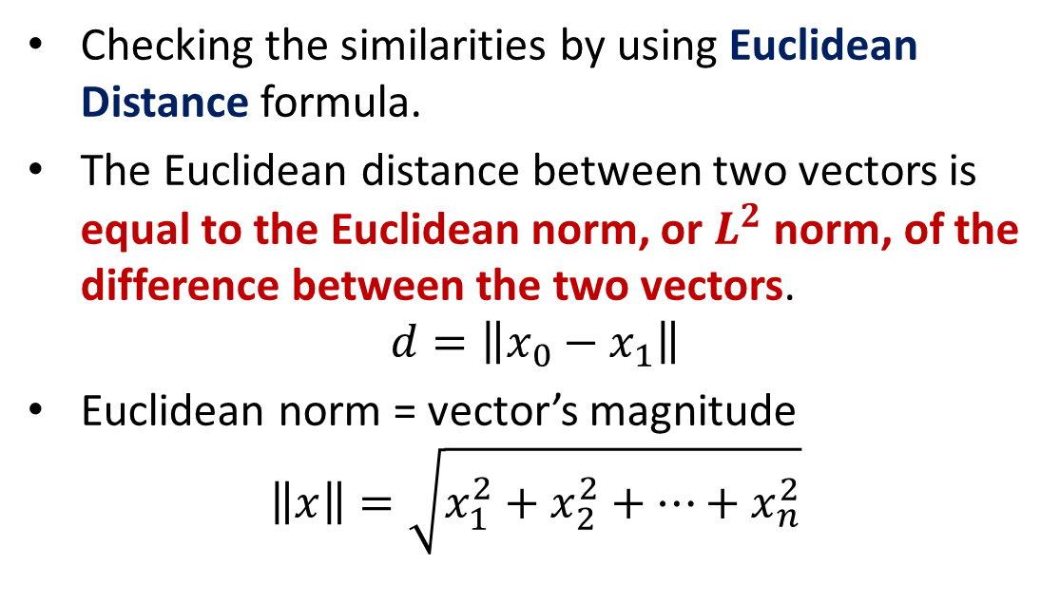
The Bag-of-Words Example
Checking the similarities by using Euclidean Distance formula.
The Euclidean distance between two vectors is equal to the Euclidean norm, or $L^{2}$ norm, of the difference between the two vectors.
$$d=\left\|x_{0}−x_{1}\right\|$$
Euclidean norm = vector’s magnitude
$$\left\|x\right\|=\sqrt{x_{1}^{2}+x_{2}^{2}+…+x_{n}^{2}}$$

Slide 18
The Bag-of-Words Example (1)
Collect Data
Four Sentences as follows.
It was the best of times, it was the worst of times, it was the age of wisdom, it was the age of foolishness,
Design the Vocabulary
“it”
“was”
“the”
“best”
“of”
“times”
“worst”
“age”
“wisdom”
“foolishness”

Slide 19
The Bag-of-Words Example
Create Document Vectors. Take the first sentence.
“it” = 1
“was” = 1
“the” = 1
“best” = 1
“of” = 1
“times” = 1
“worst” = 0
“age” = 0
“wisdom” = 0
“foolishness” = 0
It creates the binar vector [1, 1, 1, 1, 1, 1, 0, 0, 0, 0]
How about the other sentences?

Slide 20
Stop Word Filtering
Strategy for reducing the dimensionality of text data:
To convert all of the text to lowercase. The letter case does not contribute to the meanings of most words
To remove words that are common to most of the documents in the corpus, called stop words. They often functional words that contribute to the document's meaning through grammar rather than their denotations

Slide 21
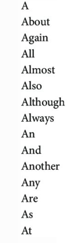
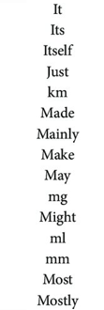
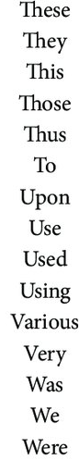
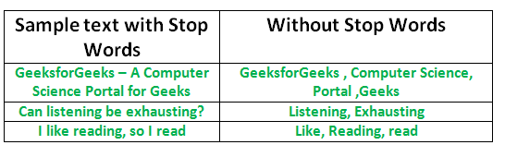
Stop Word Filtering Example

Slide 22
Stemming and Lemmatization
Applied to a large corpus.
Stemming and lemmatization are two strategies for condensing inflected and derived forms of a word into a single feature.
Lemmatization is the process of determining the lemma, or the morphological root, of an inflected word based on its context. Lemmatization frequently requires a lexical resource.
Stemming removes all patterns of characters that appear to be affixes, resulting in a token that is not necessarily a valid word.

Slide 23
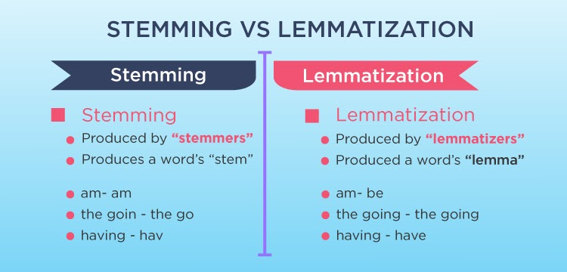
Stemming and Lemmatization Example

Slide 24
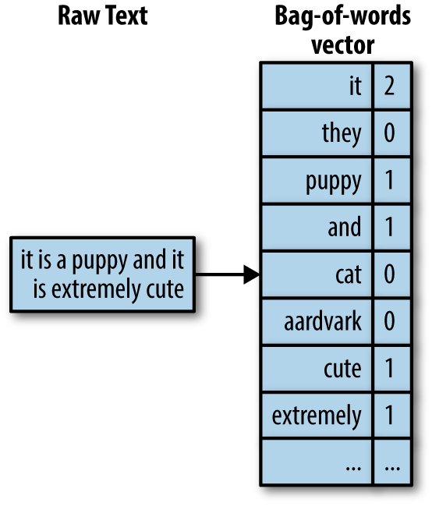
Extending Bag-of-Words with TF-IDF Weights
For creating feature vectors that encode the frequencies of words.
Use an integer that represents the number of times that the words appeared in the document.

Slide 25
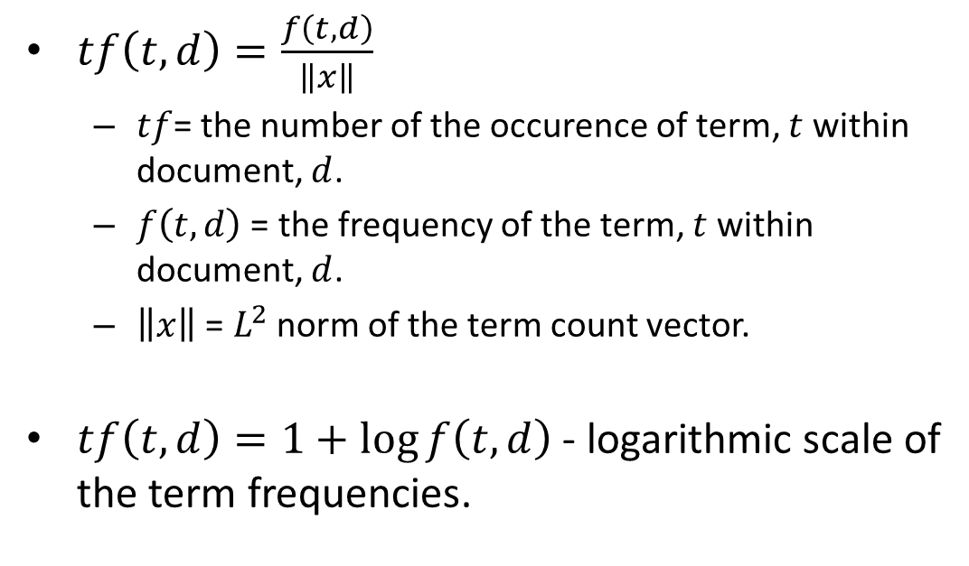
Extending Bag-of-Words with TF-IDF Weights
$tf\left(t,d\right)=\frac{f\left(t,d\right)}{\left\|x\right\|}$
$tf$= the number of the occurence of term, $t$ within document, $d$.
$f\left(t,d\right)$ = the frequency of the term, $t$ within document, $d$.
$\left\|x\right\|$ = $L^{2}$ norm of the term count vector.
$tf\left(t,d\right)=1+\log{f\left(t,d\right)}$ - logarithmic scale of the term frequencies.

Slide 26
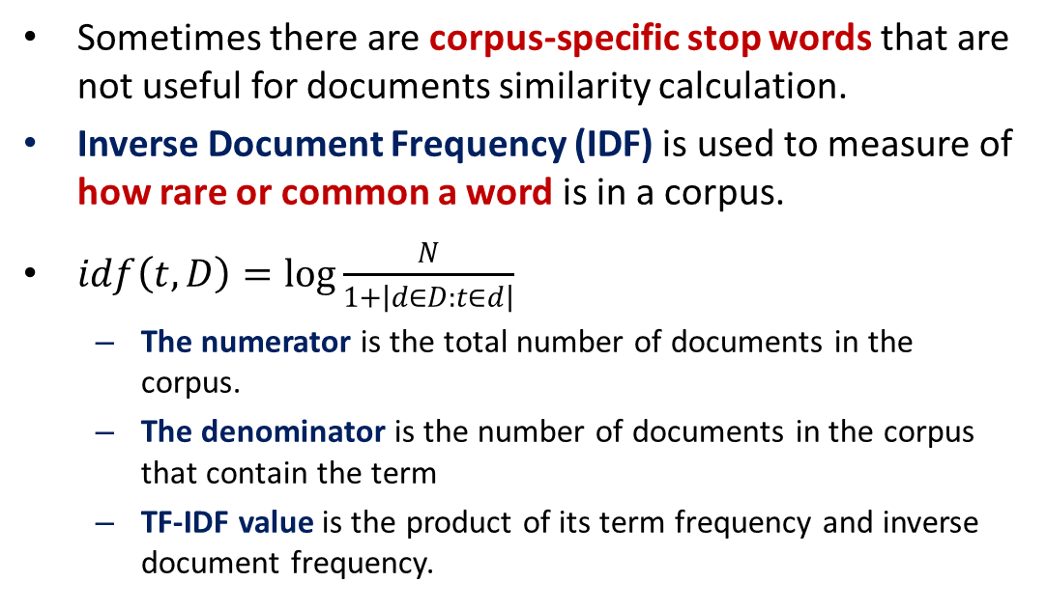
Extending Bag-of-Words with TF-IDF Weights
Sometimes there are corpus-specific stop words that are not useful for documents similarity calculation.
Inverse Document Frequency (IDF) is used to measure of how rare or common a word is in a corpus.
$idf\left(t,D\right)=\log{\frac{N}{1+\left|d∈D:t∈d\right|}}$
The numerator is the total number of documents in the corpus.
The denominator is the number of documents in the corpus that contain the term
TF-IDF value is the product of its term frequency and inverse document frequency.

Slide 27
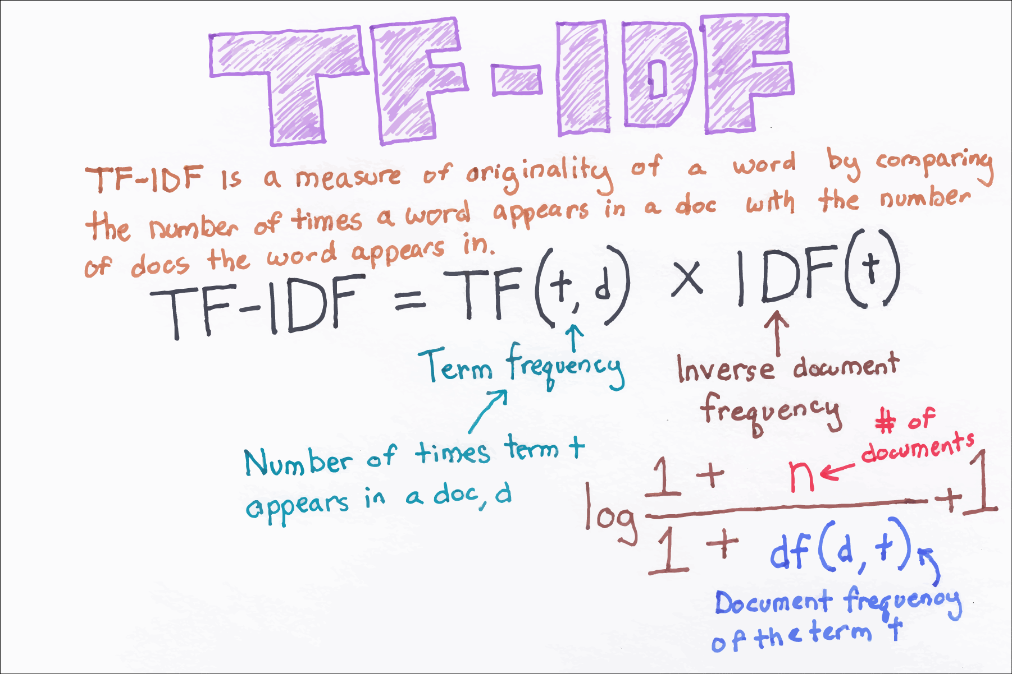
Extending Bag-of-Words with TF-IDF Weights

Slide 28
Space-Efficient Feature Vectorizing with the Hashing Trick
Reduce the process in creating feature vectors to reduce the use of the memory for storing the feature vector.
Use signed hash function to eliminate the possibility of hash collision.
Disadvantage:
loss of information.
the resulting model is more difficult to inspect, as the dictionary is not stored.

Slide 29
Word Embeddings
Parameterized functions that take a token from some language as an input and output a vector.
Essentially a lookup table that is parameterized by a matrix of embeddings.
Typically learned through training a model for a different task.
A technique where individual words of a domain or language are represented as real-valued vectors in a lower dimensional space.
The model:
The first component is essentially our word embedding function; given a token, it outputs a vector.
The second component is a binary classifier that predicts whether the five vectors represent a valid sequence of tokens.

Slide 30
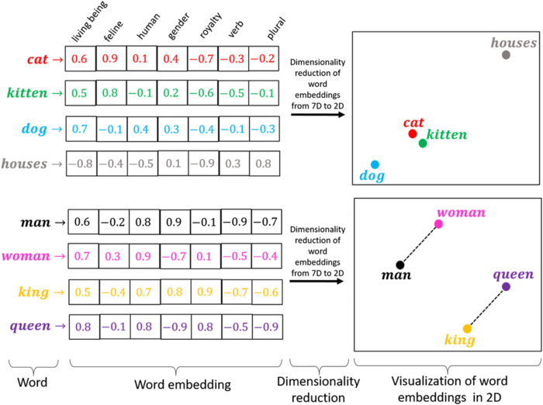
Word Embeddings

Slide 31
Extracting Features from Image
A digital image is usually a raster, or pixmap, that maps colors to coordinates on a grid.
An image can be viewed as a matrix in which each element represents a color.
A basic feature representation for an image can be constructed by reshaping the matrix into a vector by concatenating its rows together.
Optical Character Recognition (OCR) is a canonical machine learning problem.

Slide 32
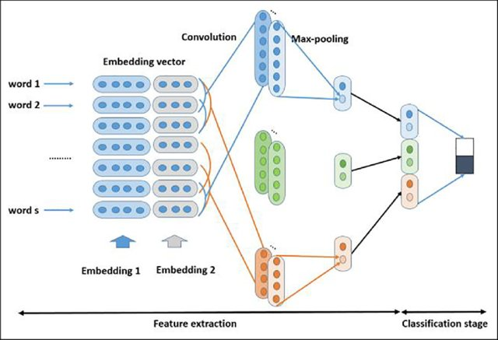
Using Convolutional Neural Network Activations as Features
https://www.researchgate.net/publication/333752473_Real-time_event_detection_using_recurrent_neural_network_in_social_sensors/figures?lo=1

Slide 33
Thank You for Today
Always Keep Your Spirit!

